Slide 1


Distributed Raytracer
ITCS 422 - Distributed Systems

Slide 2
Summary
Working methods
Distributed System
Server architecture
Client architecture
Raytracing principle

Slide 3
Git - versioning system
Calculus
Allow us to work each on a different branch from “stable revision”
We have a demonstration revision, which is always stable
Server
Client
Master
Final version
Time

Slide 4

Distributed System
Servers are connected in a Peer-to-peer architecture
Servers are identified by UID (Unique IDentifier)
Servers broadcast informations using Recursive Strategy
Clients can connect to any server
3
4
1
Connection
2

Slide 5
DS: Assigning UID
A
B
How to deal with new UID:
Scenario: “A” try to connect to “B”
Source | Destination | Message
A | B | Server Authentication: I’m a server, not a Client
B | A | Your Id is “4”
B | A | I confirm, your id is “4”
B | A | I am “1”, I’m connected to server “2”
A | B | I am connected to server “5” and “6”

Slide 6
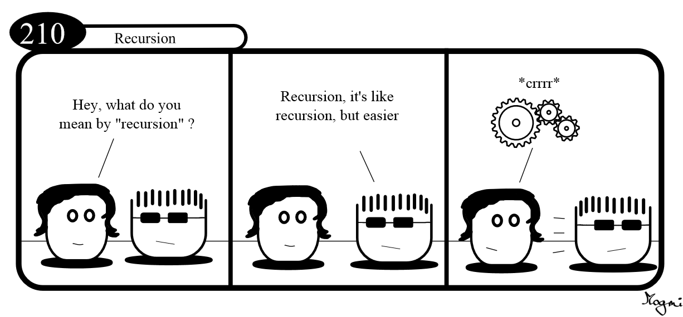
DS: Recursive data transfer
Notes:
Here I’ll draw packet-recursion sending schema on whiteboard

Slide 7
DS: Recursive data transfer
3
4
1
Example:
Sending informations from server 4 to server 1
Connection
Data transmission
2

Slide 8
Server architecture
The server is:
Using config file
Modular
Using threads

Slide 9
Server: Config files
[peers]Server 192.168.0.15:42414Server 192.168.0.16:42414#Server 192.168.0.16:42419[server]#NoListenListen 8040MaxClient unlimited[worker]MaxThreads 2
Homemade Config file interpreter
Common syntax in Unix system
Easy to read for a human
Easy to understand

Slide 10


Server: Modular
When started, the server will search for all dynamic libraries from the “Modules” directory, and try to load them.
These modules include features such as :
3D objects, like sphere or cylinder
Transformations, like translation or rotation
Shaders, like opacity or textures
Modules/
BasicLight.so
BasicObject.so
BasicTransform.so
AdvancedLight.so

Slide 11
Server: Modular
Common Interface implementation for all modules
Return type | Function name | Parameters
void | preProcess | Camera, Ray
double | computeEquation | Camera, Ray
Color | getColor
Color | postProcess | Scene, Camera, Ray, Object, double, Color | Object found Distance eye - object
3DCoord | getPerpendicular | 3DCoord, 3DCoord

Slide 12
Server: Threading
When the network thread receives a new scene or a compute instruction, events are fired to the workers.
When a worker finishes, an event is fired back to the network thread
Worker 1
Worker 2
Worker 3
Event bus
Network thread
Console
Process

Slide 13
Client architecture
Renderer
Calculus Worker
Listener Worker
UI Thread

Slide 14
Listener Worker
Listener Worker
Connection
Event
Calculus
Event
Monitoring
Event
UI Thread

Slide 15


Calculus Worker
Final Scene
CHUNK RESULT
UI Thread

Slide 16
Making Animations !
BOOM
Frame 1
Scene
Empty
Frame
Animator
Frame 2
New
Frame
Scene
Empty
Frame
Frame 3
UI Thread

Slide 17


Making Animations ! Part 2
Making the awesome
Frame 1
Animator
Frame 2
Frame 3

Slide 18
Ray Tracing principle
The ray tracing is a technique for generating images from virtual scenes.
It traces the path of a light ray for each pixels of the image and simulates its encounter with virtual objects.
Ray tracing is used for animated movies.

Slide 19
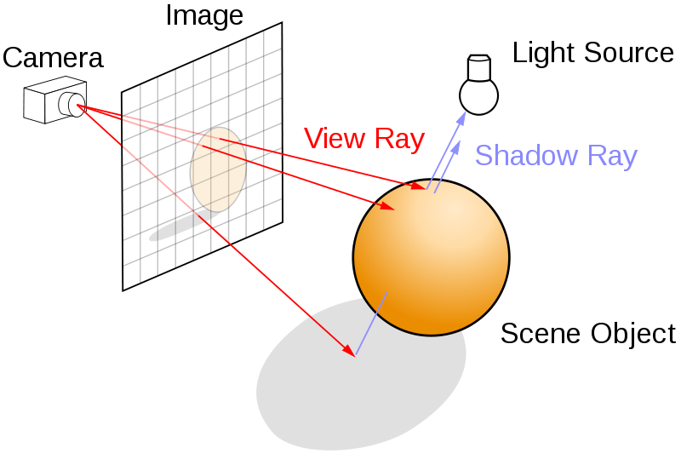
Ray Tracing principle
In real life, light comes
from the light source
and goes to the camera.
But it’s the inverse in
ray tracing.

Slide 20
Object : Sphere
a = (ray x)² + (ray y)² + (ray z)²
b = 2 * ((camera x) * (ray x) + (camera y) * (ray y) + (camera z) * (ray z))
c = (camera x)² + (camera y)² + (camera z)² - (sphere r)²
d = b² - 4 * a * c
k1 = (-b - sqrt(disc)) / (2 * a)
k2 = (-b + sqrt(disc)) / (2 * a)
(k => distance between intersection and camera)
k1
k2
Sphere equation :
r² = x² + y² + z²

Slide 21
Light
color = (object color) x (cosinus of A) + (spot color) x brightness
A

Slide 22
Transparency & Reflexion
Reflexion
Transparency
A
A
color = (object 1 color) x (coef) + (object 2 color) x (1 - coef)

Slide 23
Let’s see it in action !

Slide 24
Specials thanks
For his awesomeness
Dr. Ahmed Al Jumaili
For mathematics advises
Bastien G.
Walid B.

Slide 25
Thanks for listening
Some questions ?

